Slide 1
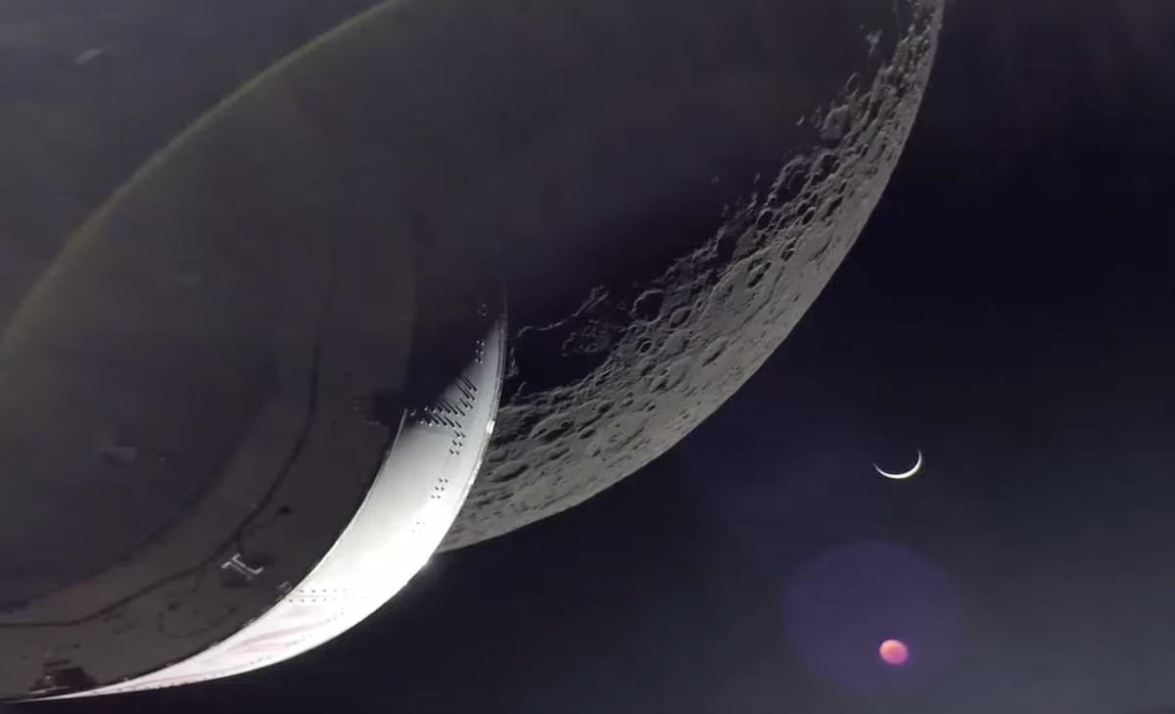
RASC Toronto Centre Recreational Astronomy Night
The Sky This Month
Dec 7, 2022 to Jan 4, 2023
By Chris Vaughan - December 7, 2022 Artemis 1 Coming Home NASA TV Image

Slide 2
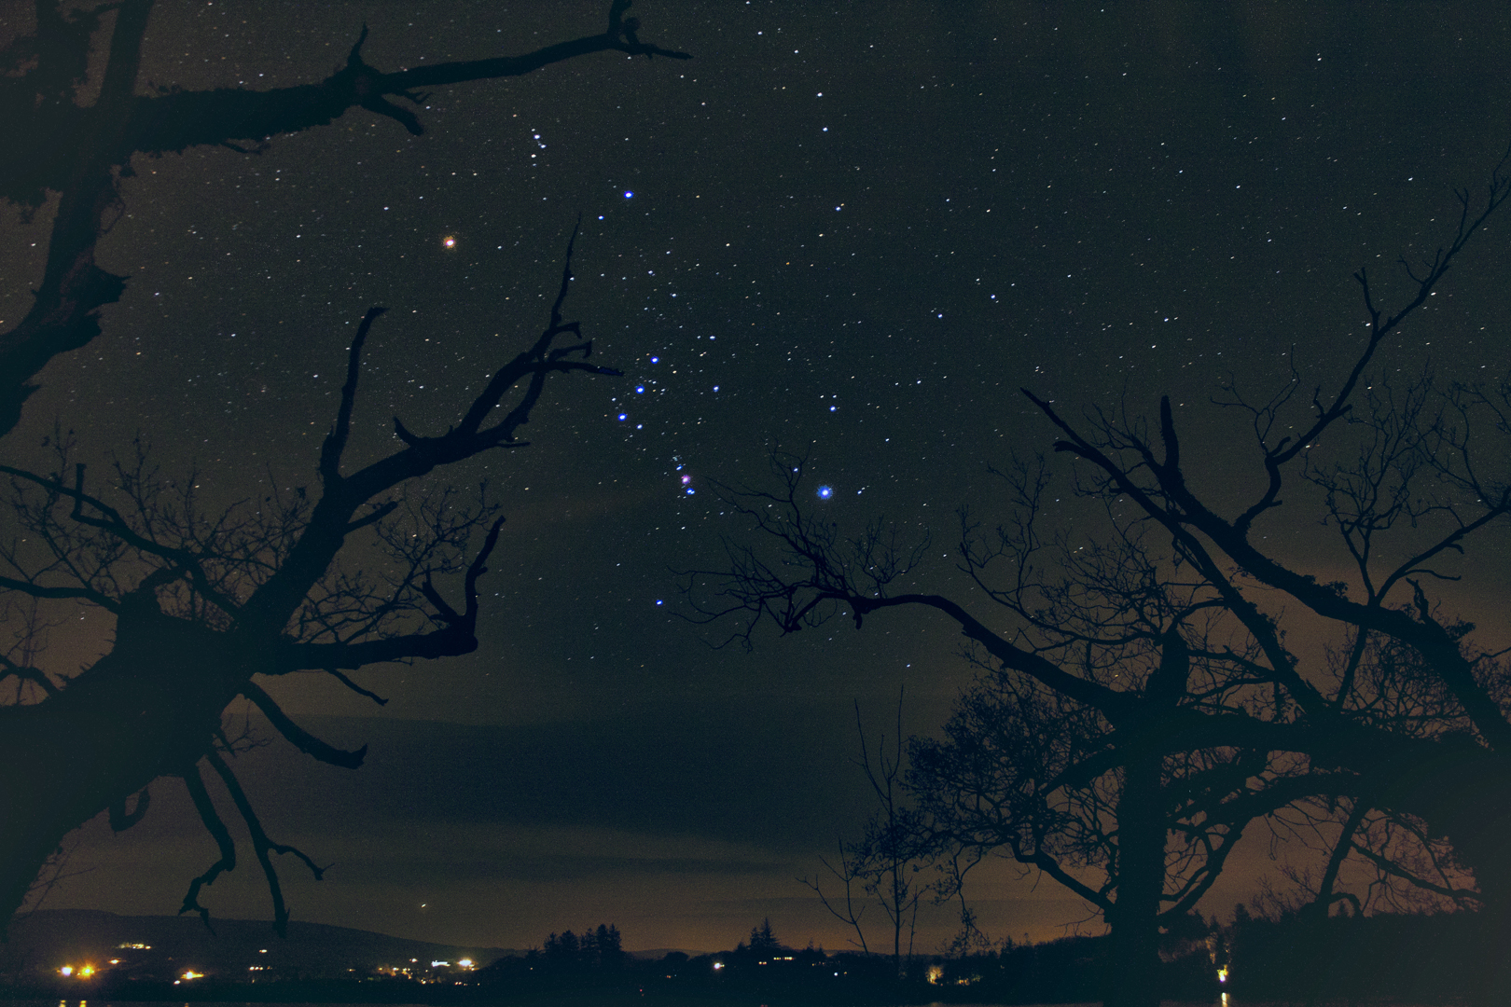
Outline
Space Exploration News
Observing (times in Eastern Daylight Savings Time, UT-5)
Sun and Moon
Planets and Dwarf Planets
Comets, Asteroids, etc.
Satellite Passes
Variable Stars, Double Stars, Early Winter Targets
Presentation and extra content is posted at www.rascto.ca
NASA APOD by Brendan Alexander, Donegal Skies, Ireland

Slide 3
Acknowledgements
Member images used with permission
Stephen McKinney
Michael Watson
Lynn Hilborn

Slide 4
TSTM – Headlines!
Dec 7 - Full Moon Occults Mars at Opposition
11.5 hours of Imaging time!
Dec 9 – Watch Algol Fade all evening
Geminids, Ursids, and Quadrantids!
Dec 21 – Mercury at Greatest Eastern Elongation
Dec 21 – Northern Winter Solstice
Dec 29 – Mercury passes 1.5° from Venus
Artemis 1 - NASA TV image

Slide 5
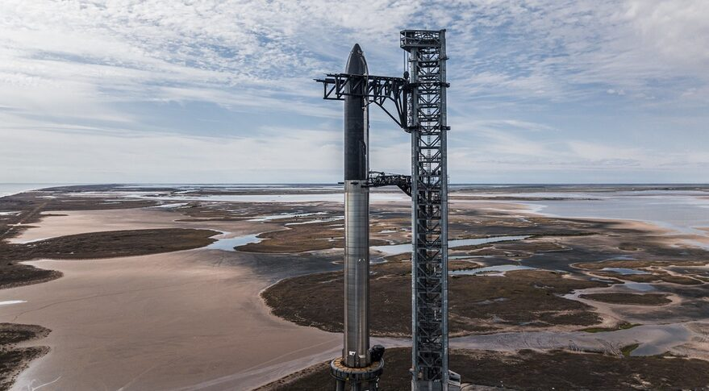
News – Space Exploration
Artemis 1 is due to re-enter Earth’s atmosphere on Sunday, December 11 at 1:06 pm EST or 18:06 UTC
Dec TBD at approx 3 am EST - A Falcon 9 rocket from Cape Canaveral Air Force Station, Fl, first commercial Hakuto-R lunar lander for ispace, called ispace Mission 1, including two small lunar rovers from the United Arab Emirates and Japan. The mission will target a landing in the Lacus Somniorum region of the moon
Dec TBD - A SpaceX Super Heavy rocket from Boca Chica, Texas, Starship launch Earth orbit, re-entry, and splashdown near Hawaii

Slide 6
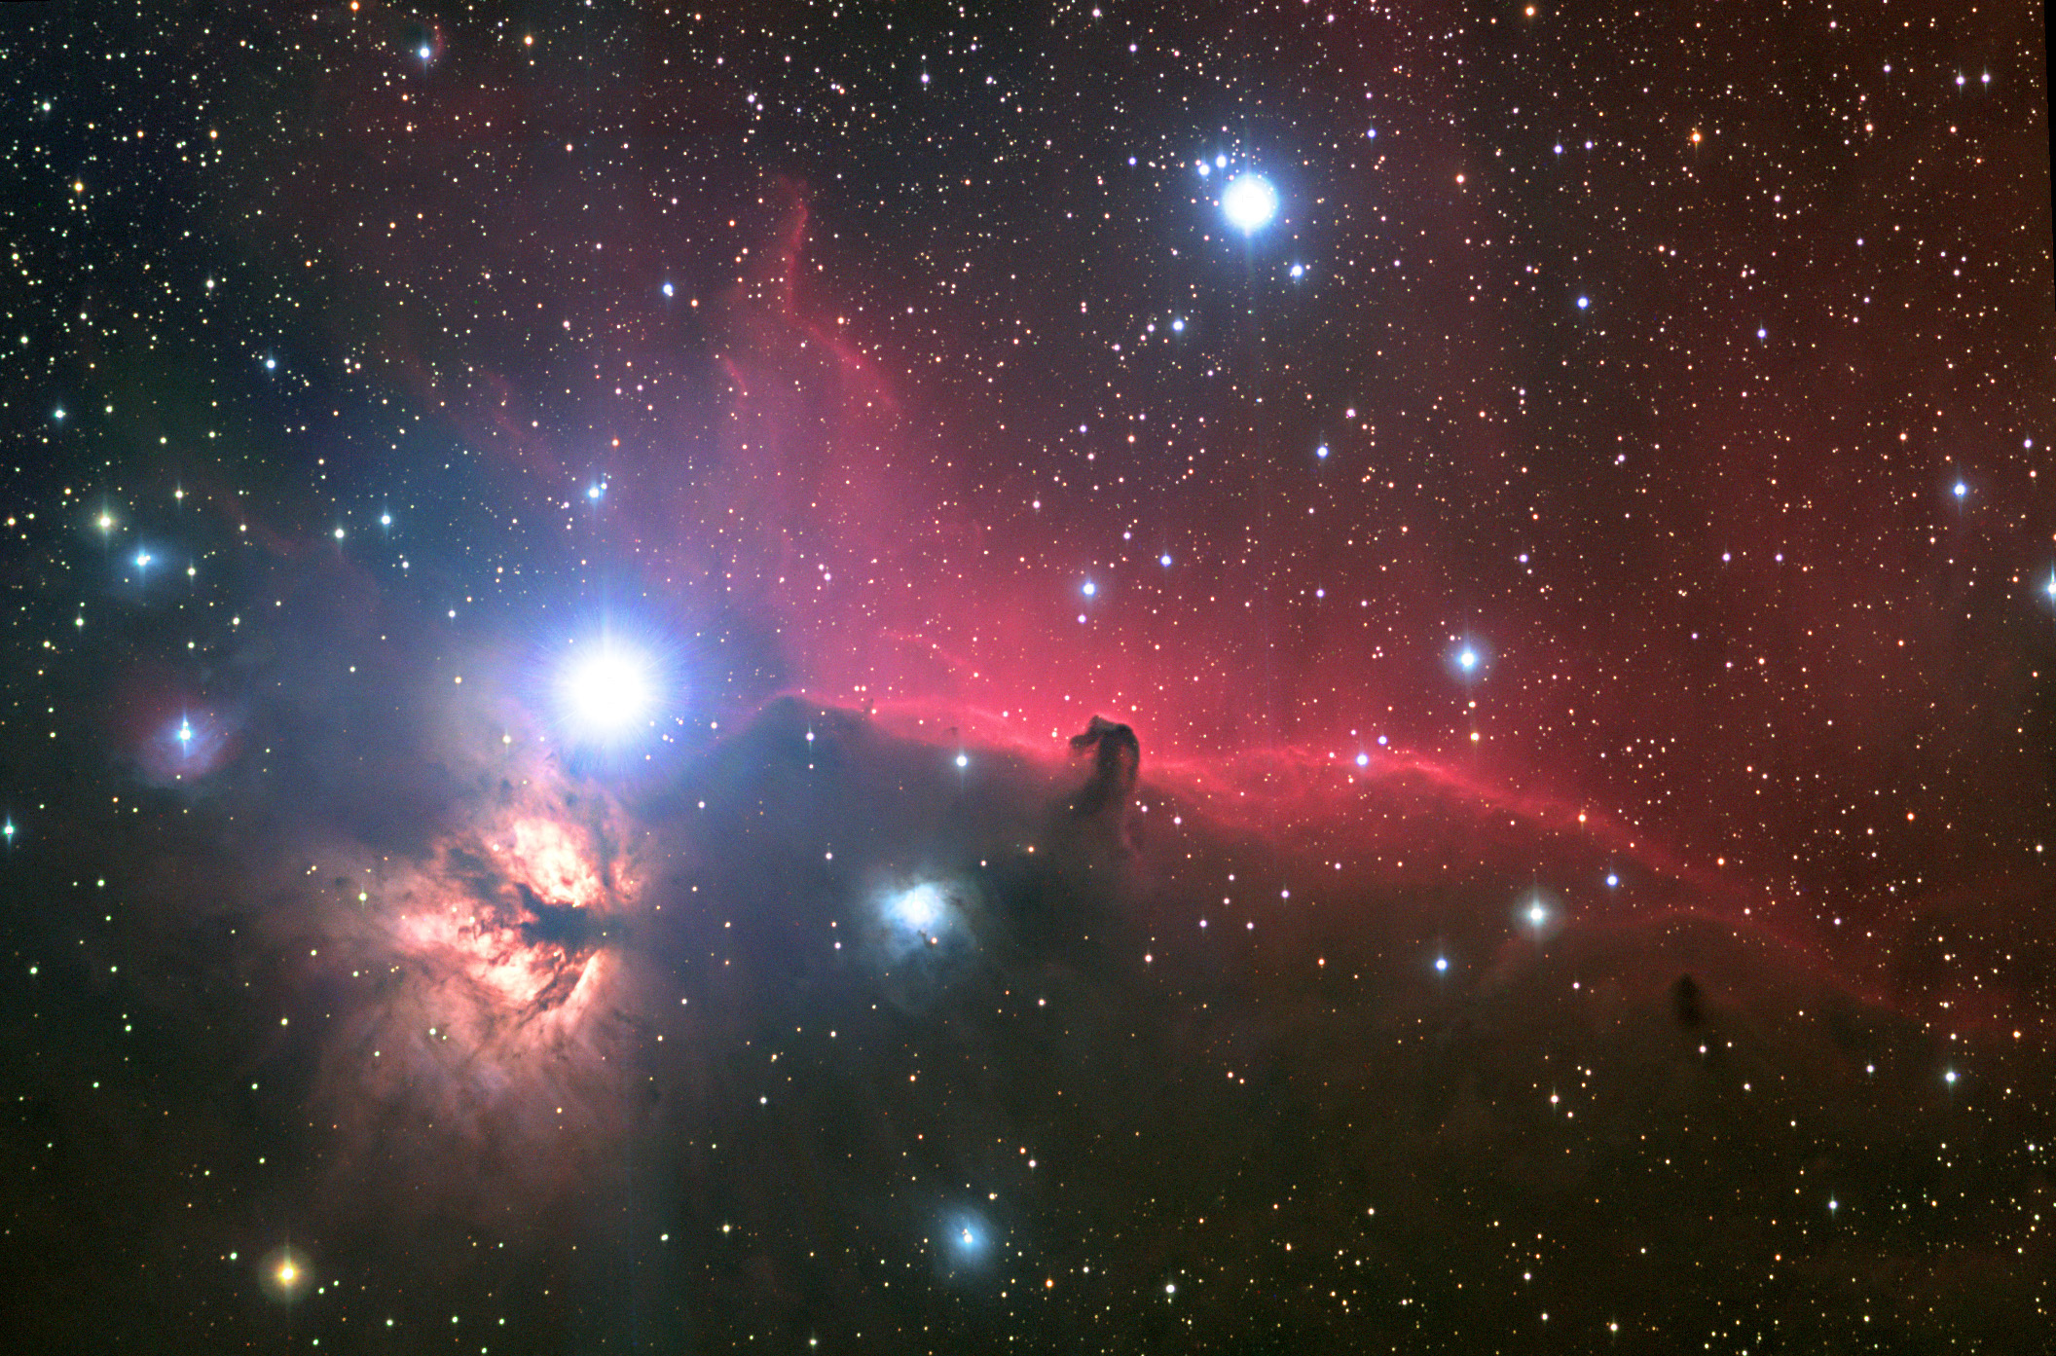
Observing
Alnitak region image by Ryan Steinberg, APOD Mar 21, 2005

Slide 7
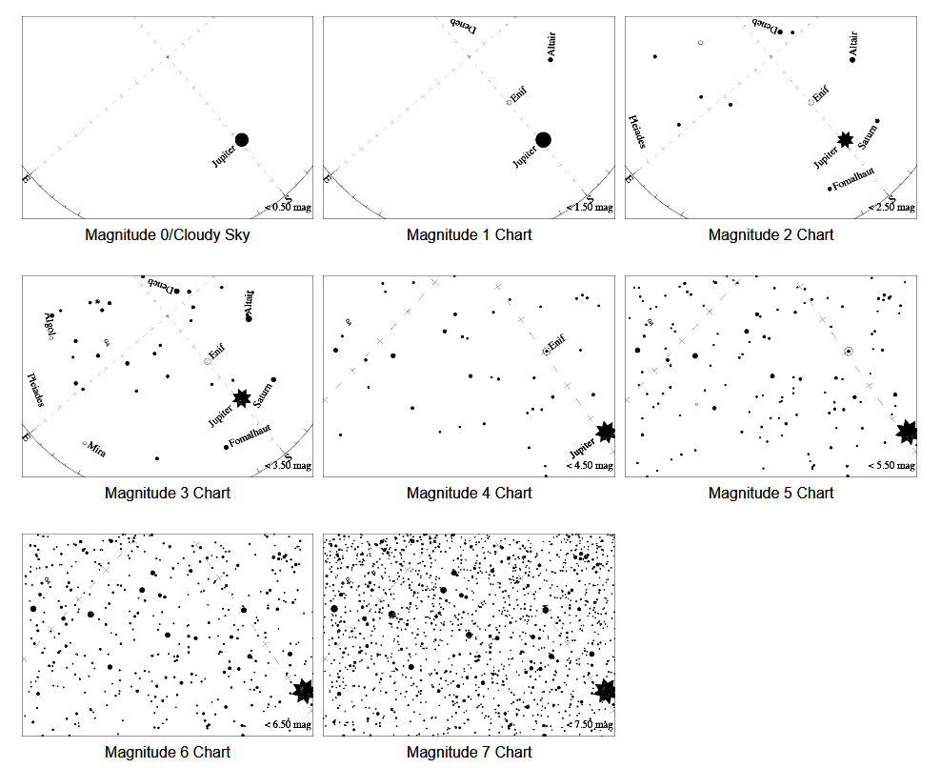
Observing – Globe at Night 2022/3
RASCals wanted…to map light pollution
During observing
period, visually
measure limiting
magnitude of
stars at your
location
Observe Pegasus
Dec 15 to 24

Slide 8
Observing – Globe at Night 2022/3

Slide 9
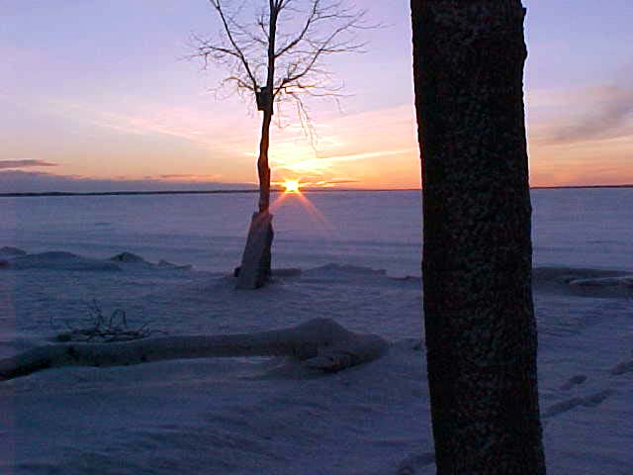
Observing – Sunrise / Sunset
December 7, sunrise at 7:37 am, sunset at 4:40 pm (9h03m of daylight) Year’s earliest sunset on Dec 9
January 4, sunrise at 7:51 am, sunset at 4:54 pm (9h03m of daylight) Year’s latest sunrise around Jan 3
December 21 at 4:48 pm – Northern Winter Solstice
January 4 at 11 am – Earth at perihelion (147.099 Mkm)

Slide 10
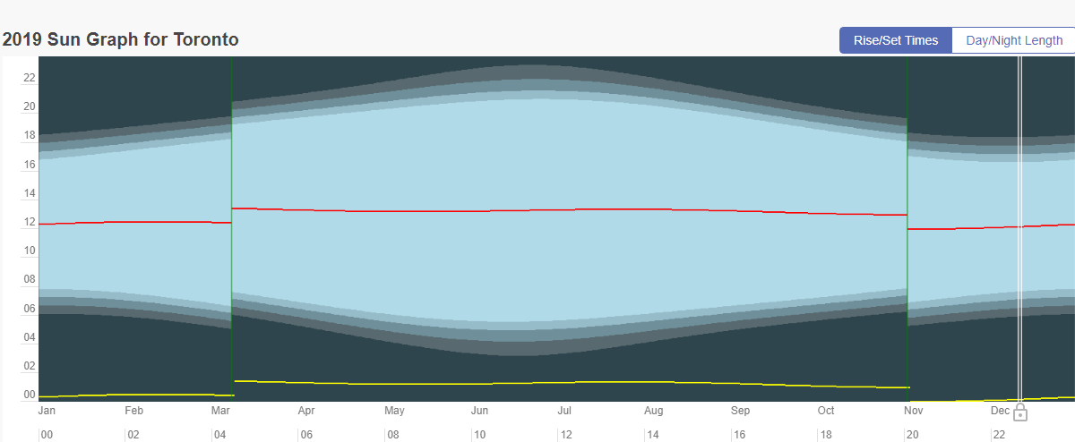
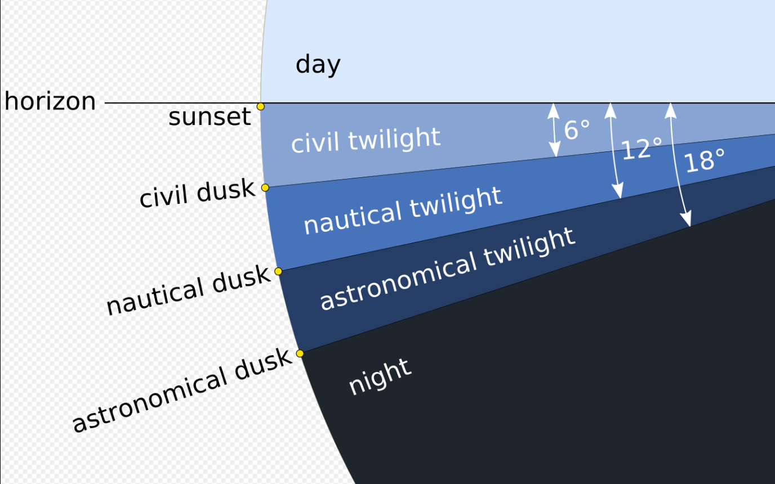
Observing – Astronomical Twilight
Dec 7, A.T. ends at 6:23 pm and starts at 5:54 am
(11h31m of imaging time) (~1 min more per day)
Jan 4, A.T. ends at 6:37 pm and starts at 6:07 am
(11h30m of imaging time) (~1 min less per day)

Slide 11
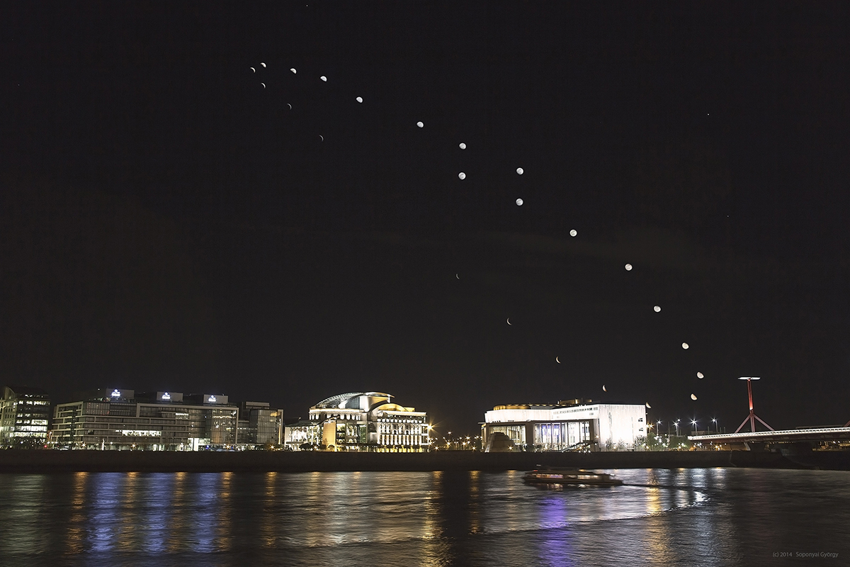
Observing – Moon Phenomena
Apogee – Sun, Dec 11 at 5 pm
Perigee – Sat, Dec 24 at 3 am high tides
Wed, Dec 7 at 11:08 pm - Full Oak/Cold/Long Nights Moon
(Mars Occultation)
Fri, Dec 16 at 3:56 am - Third Quarter Moon
(rises around midnight)
Fri, Dec 23 at 5:17 am - New Moon at perigee; large tides
Thu, Dec 29 at 8:20 am - First Quarter Moon
(sets around midnight)
Earth Sci POD by Gyorgi Soponyai, taken over the Danube in Budapest, Hungary from Mar 15-April 14, 2014

Slide 12
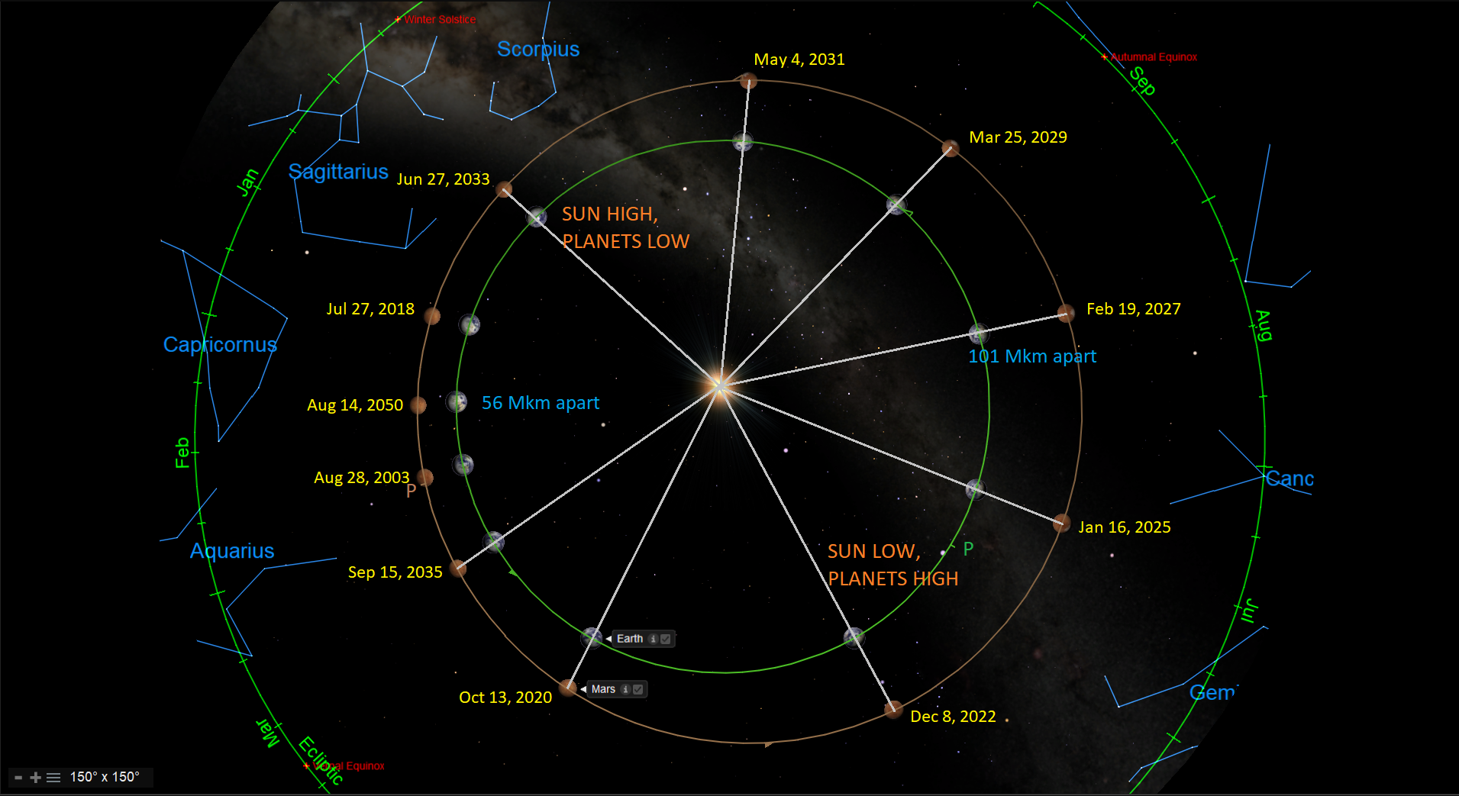
Observing – Mars at Opposition
MARS reaches opposition around midnight EST on Wed., Dec 7, one week after closest approach. Oppositions every ~25.6 months

Slide 13
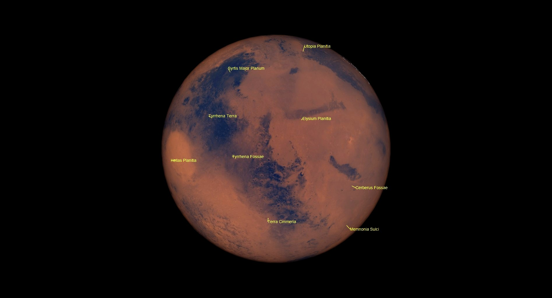
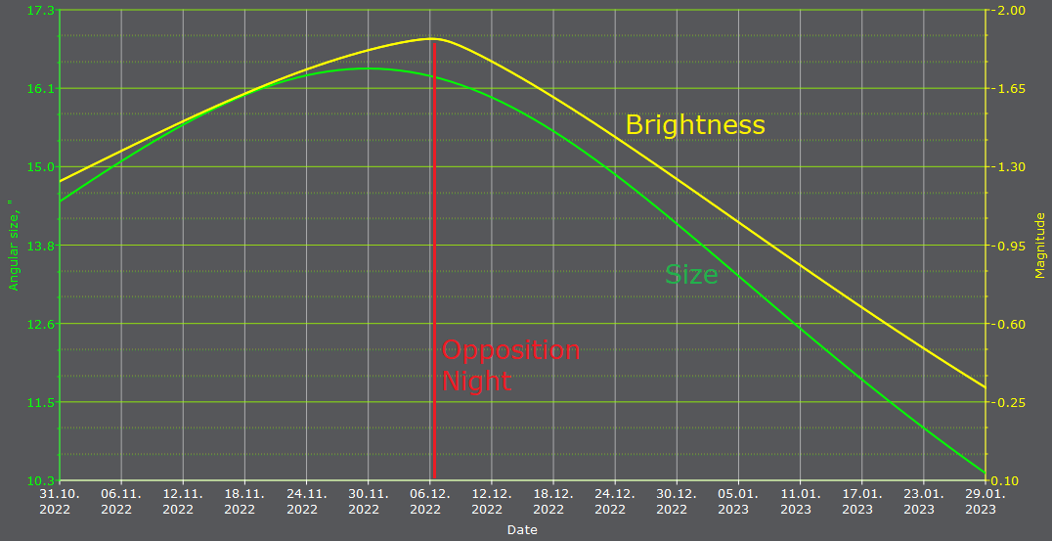
Observing – Mars at Opposition
MARS Earth-facing side at 12 am EST on Wed., Dec 7 (unflipped)
Peak mag of -1.97 enhanced by Opposition Surge
82.15 million km or 4.72 light-minutes away
17.05 arc-seconds wide

Slide 14
Observing – Mars at Opposition
Observing Tips for Mars
Higher elevation is better (Mars culminates around 1 am)
Take long looks to capture clear moments of seeing
Look for the moons! (mag 11.5 and 12.5)
A nice online Mars mapping tool lets you enter the date and time you are viewing Mars, and match your optics, here:
http://www.nightskies.net/skyguide/mars/mars.html
Use moon filters to reduce Mars glare
Coloured filters can enhance Mars, as follows:
#23A Light Red - Dust clouds on Mars,
#25 Red - Ice caps and surface of Mars,
#47 Violet - clouds on Mars,
#56 Light Green - Mars ice caps, and
#58 Green - Martian ice caps, clouds, and dust storms.

Slide 15
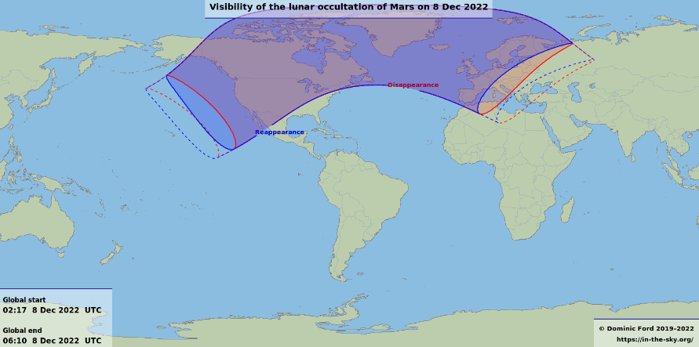
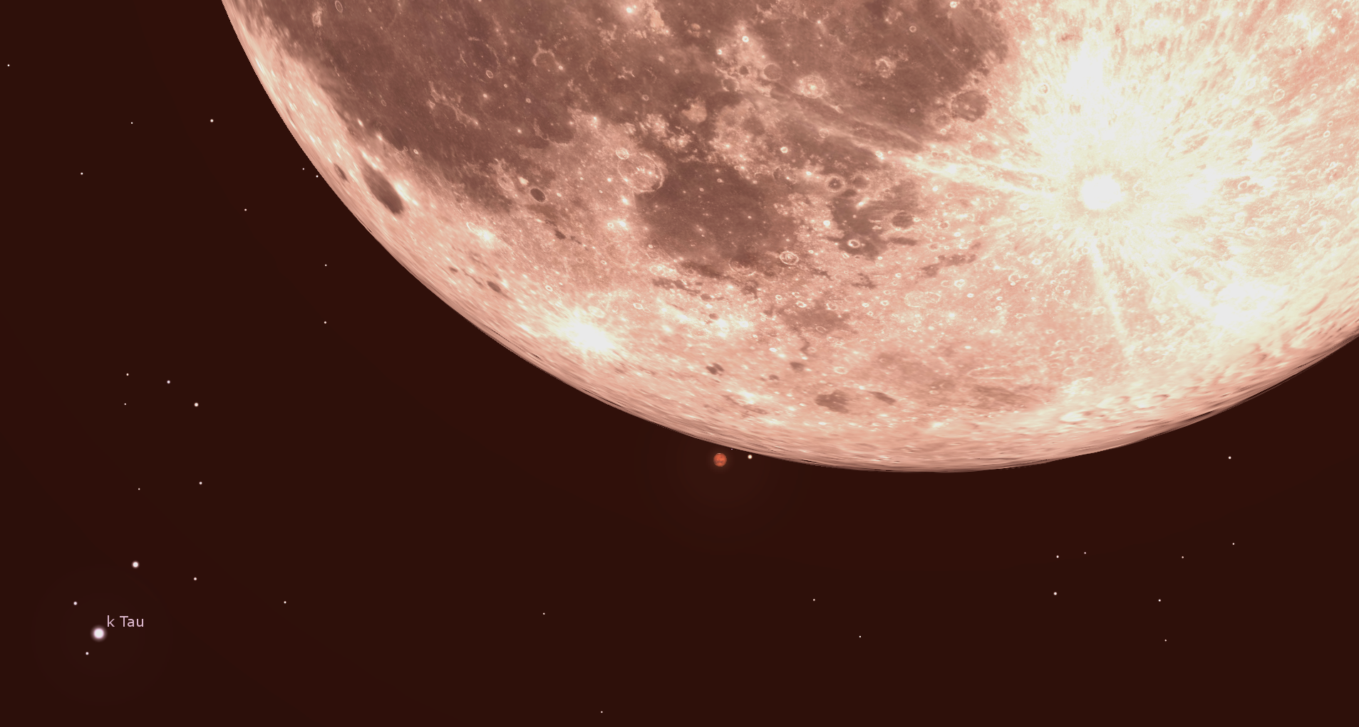
Observing – Mars at Opposition
MARS will be occulted by the full moon tonight! For Toronto…
Ingress at 10:28:39 pm EST, lasting about 75 seconds!
Re-appearance at 11:16:29 pm EST, lasting 79 seconds, from SE limb between Tycho and Stevinus

Slide 16
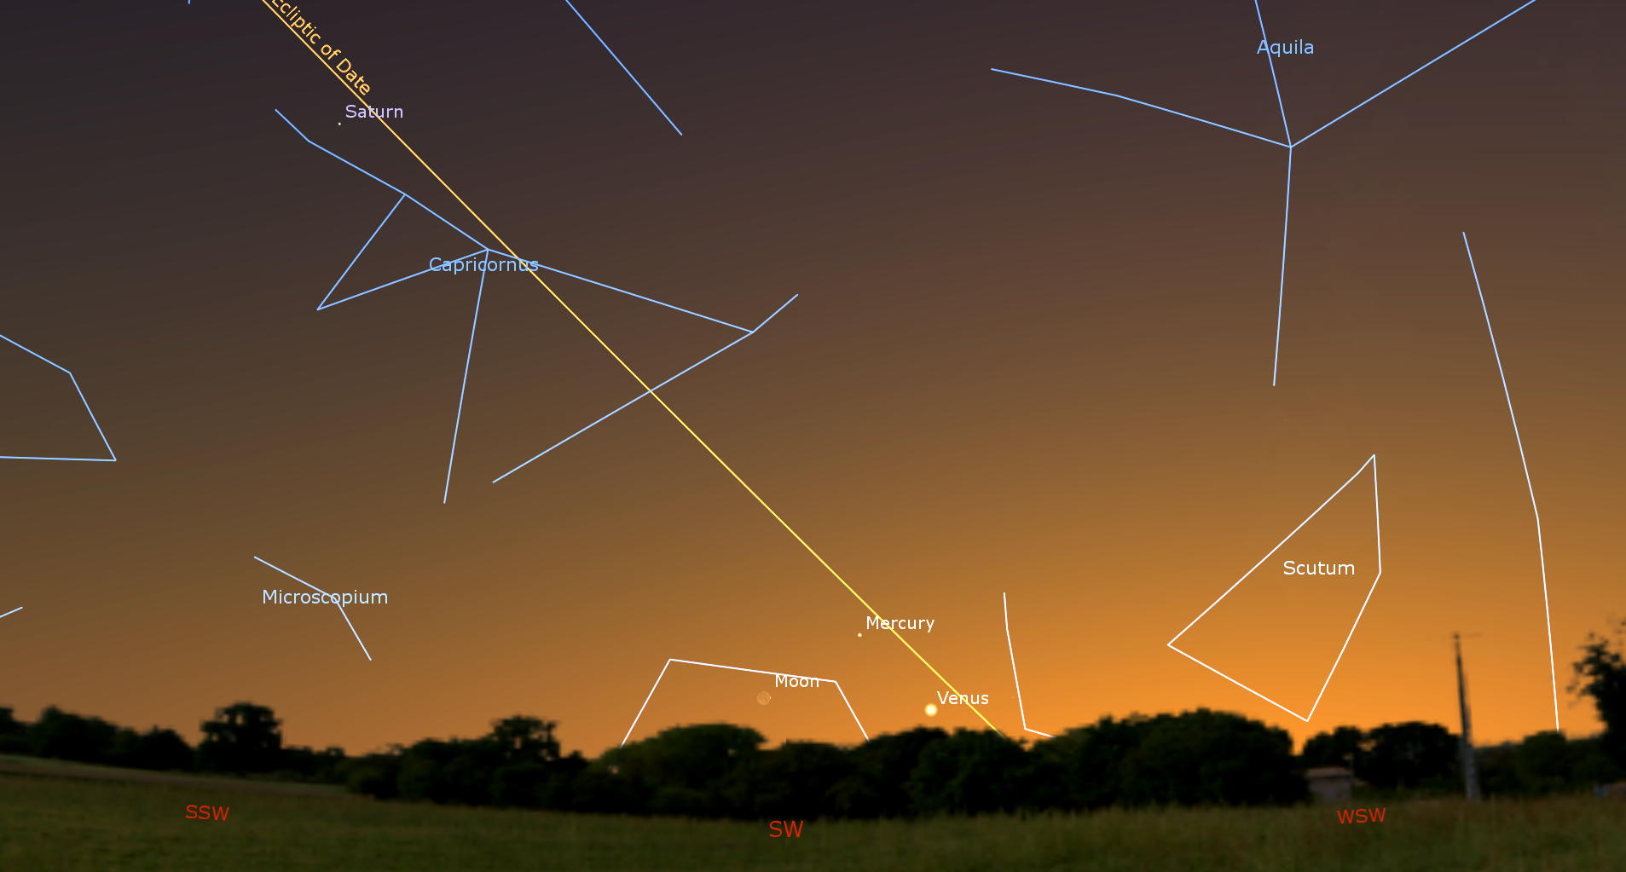
Observing – All Planets in Evening
MERCURY / VENUS
Mercury Greatest Eastern Elongation on Dec 21
Trio with crescent moon on Dec 24
Mercury and Venus 1.3° apart on Dec 28
MARS
At Opposition and Lunar Occultation on Dec 7 (tonight!)
Waning gibbous moon nearby on Jan 3
JUPITER
Near Neptune all month, and crescent moon on Dec 28 and 29
Evening shadow transits on Dec 10, 11, 15, 17, Jan 2, and more
SATURN
Moon Iapetus near min mag 12 on Dec 2-3, crosses rings on Dec 22
Near crescent moon on Dec 26
Globe’s shadow on rings decreasing
URANUS
Near bright gibbous moon on Jan 1
Dec 24 at 514 pm

Slide 17
Observing – Minor Planets
Juno
Juno (mag +9.3) evening target in Aqr between Jup & Sat
Vesta (mag +7.7) evening target in Aqr between Jup & Sat
Ceres (mag +8.6) in eastern sky after 12 am near Denebola
Pallas (mag +8.0) late night target in CMa near Wezen
View looking ESE at 8 pm on Dec 12

Slide 18
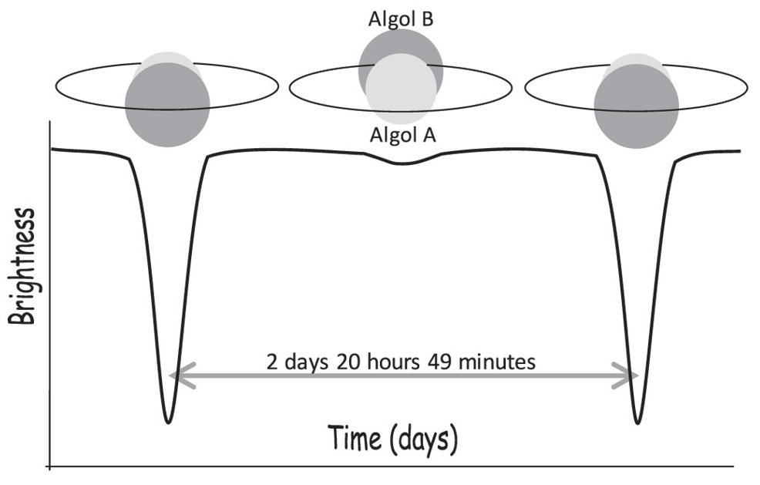
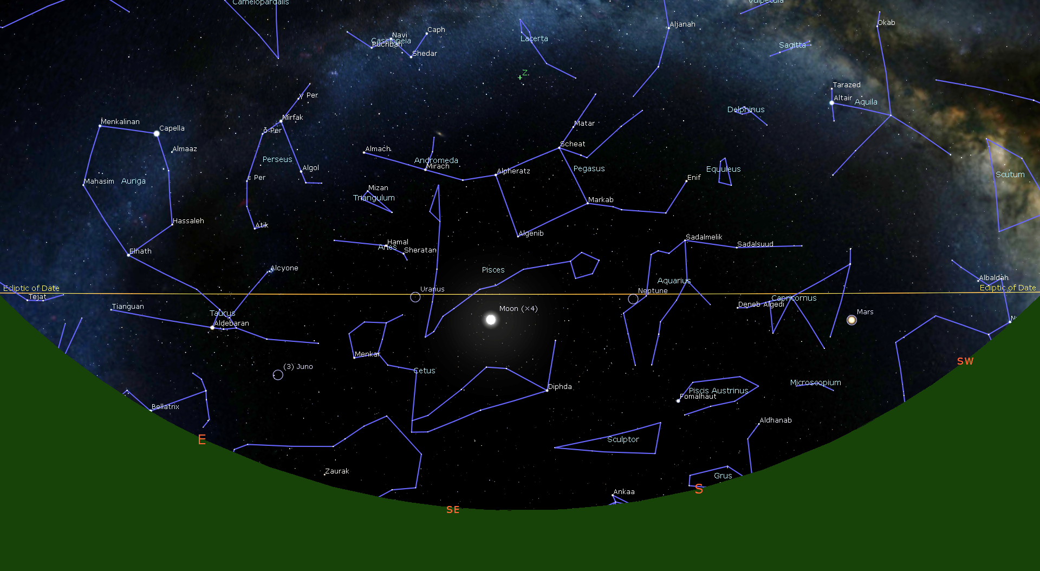
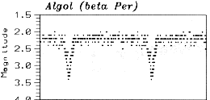
Observing – Variable Stars
Algol (Beta Persei)
Eclipsing binary system
Normally mag 2.2
Every 2.87 days it
drops to mag 3.4 and back over 10 hours
Minima:
Fri, Dec 9
at 12:08 am
(watch it fade)
Observations by John Isles, AAVSO.org
Notes:
Normally same as Almach
At minimum same as Rho Persei

Slide 19
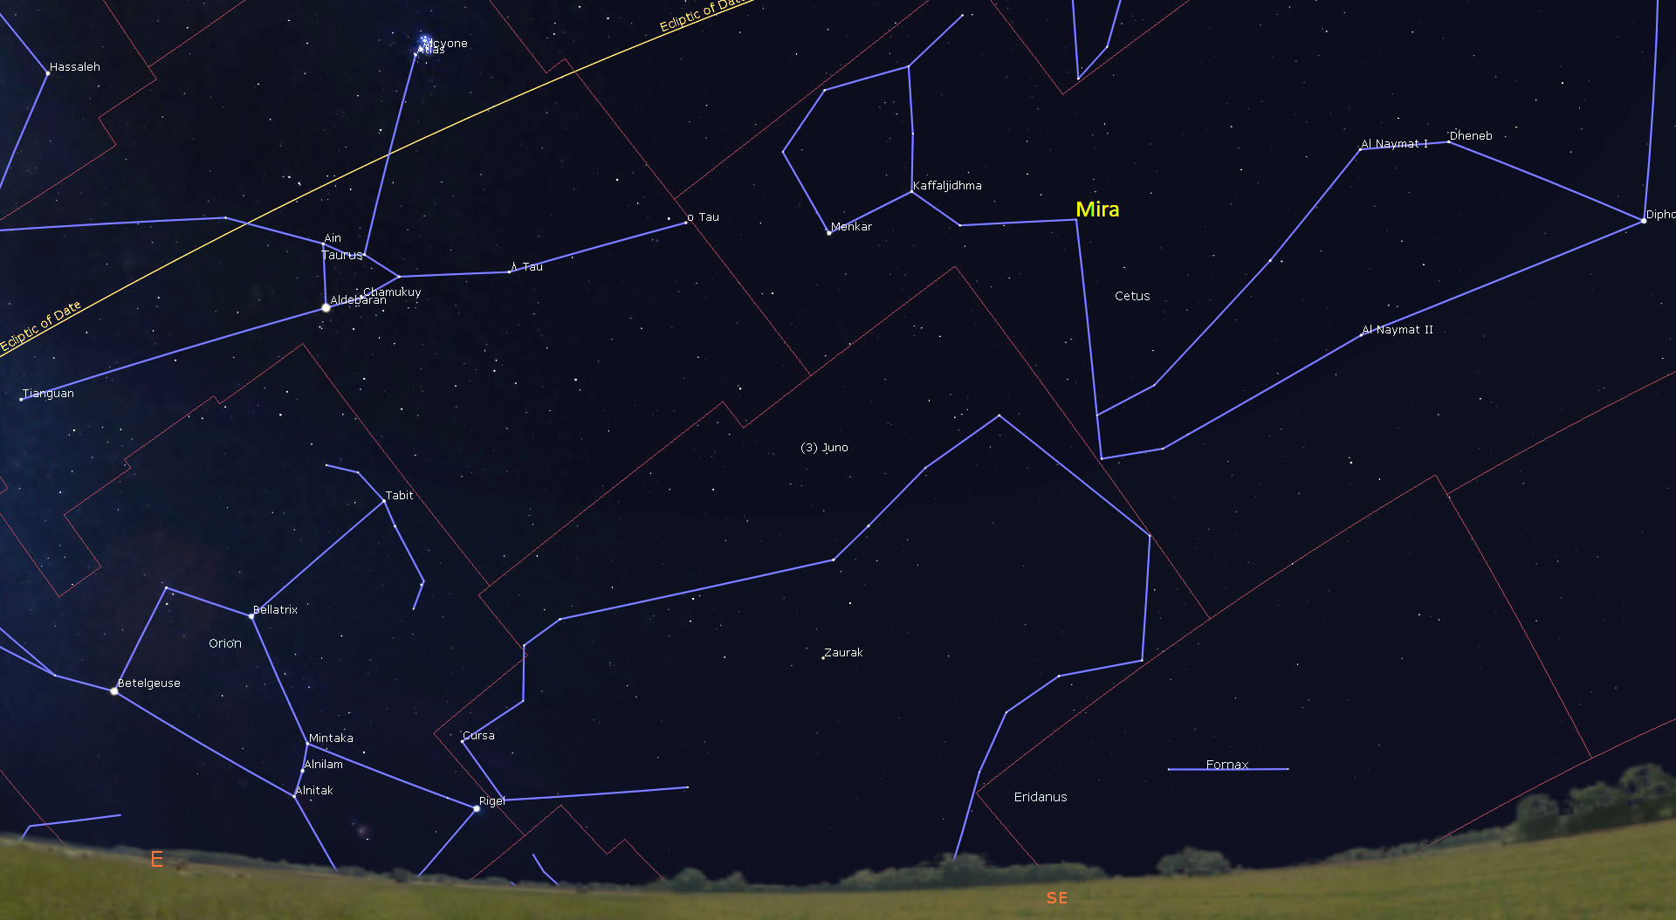
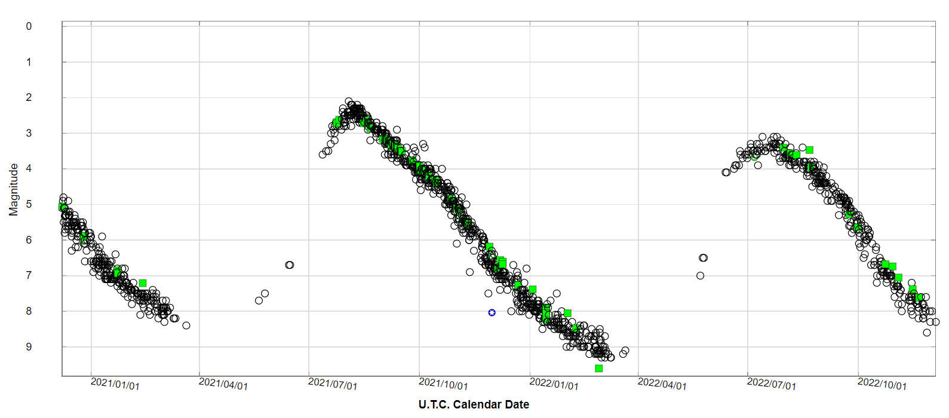
Observing – Variable Stars
Mira (Omicron Ceti)
Brightest of pulsating Mira-type variable stars
Low temp, red M7-class star, 200-300 light-years away
110 day rise from mag 9.5
to mag 3 or brighter, 220 day drop
Currently dim, bright at end of May
(AAVSO light curve for current year)
View looking SE at 7 pm on Dec 12

Slide 20
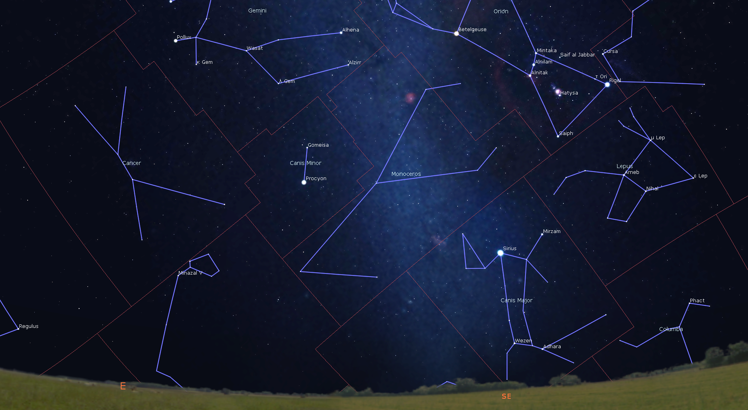
Observing – Double Stars
Sigma Orionis – Mag +4.0, beautiful 8’ long dart-shaped multiple, 49 arc-minutes SW of Alnitak
Iota Cancri - blue (mag +6.58) and
yellow (mag +4.02) separated by 30.5”
145 CMa – HR2764 or “Winter Albireo”
3.5° NE of Wezen, blue (mag +5.95) and
orange (mag +4.80) separated by 26.4”
View looking SE at 10 pm on Dec 22

Slide 21
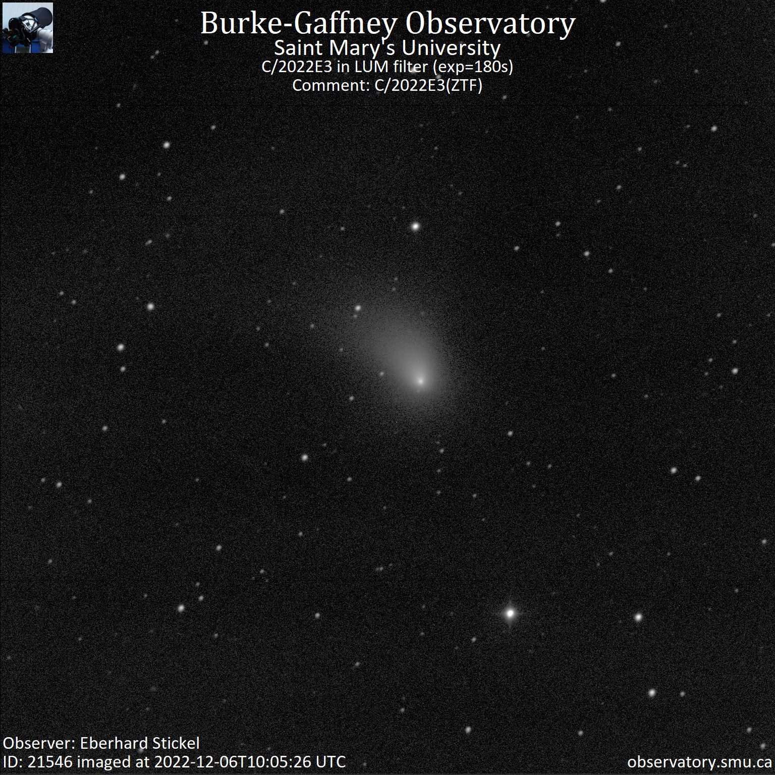
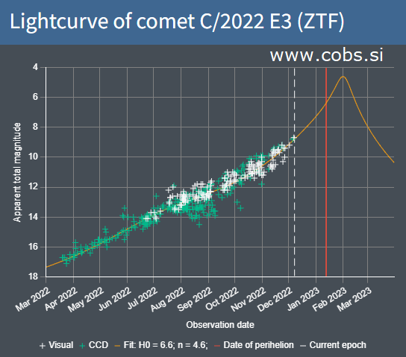
Comet C/2022 E3 (ZTF)
Mag 10.5 and brightening, in eastern pre-dawn sky after 3 am, travelling north through Corona Borealis
Predicted to reach mag 5 around Jan 30, near Polaris
Imaged Dec 6 at 22:05 UT by Burke-Gaffney Robotic Observatory

Slide 22
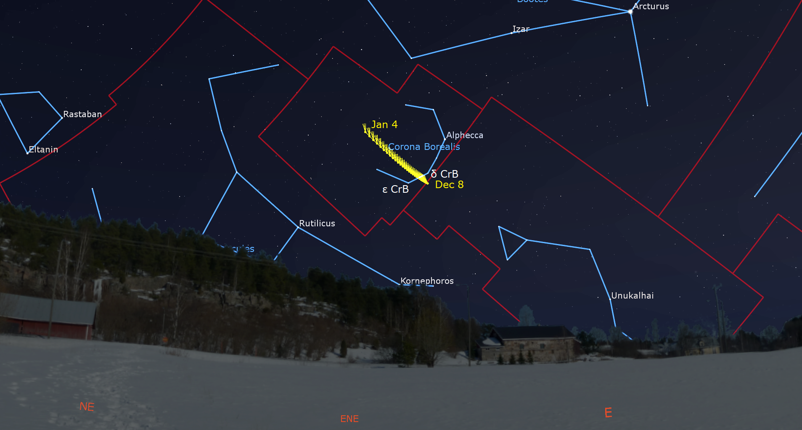
Comet C/2022 E3 (ZTF)
On Dec 15 comet C/2022 E3 (ZTF) will pass between the mag 4 stars Epsilon and Delta CrB
Path until Jan 4, shown at 5:30 am local time

Slide 23
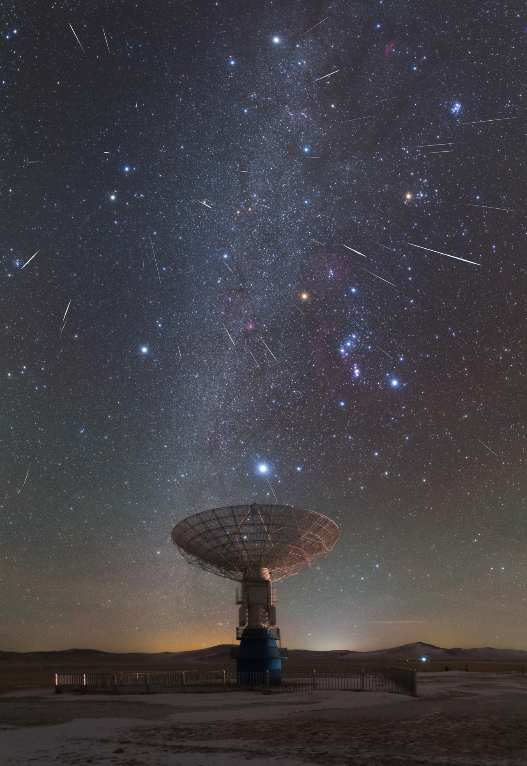
Observing – Meteor Showers
GEMINIDS (Active from Nov 19 to Dec 24)
Usually strongest shower of the year
peak overnight Tuesday, Dec 13
But bright moon rises at 9:45 pm
Often bright and intensely coloured
and slower than average because
source material is asteroid
3200 Phaethon (larger and
more solid particles)
Radiant ~1° NW of Castor in Gemini

Slide 24
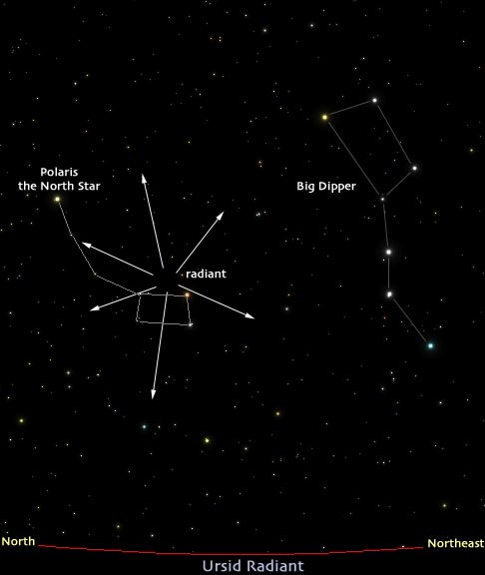
Observing – Meteor Showers
URSIDS (Active from Dec 13 to 24)
Peaks on Thursday afternoon, Dec 22, so watch Thursday morning or night
Moonless at peak!
5 to 20 Ursids per hour at peak
Some years have outbursts
Source material is comet 8P/Tuttle
Radiant is ~1° NW of Kochab in Ursa Minor

Slide 25
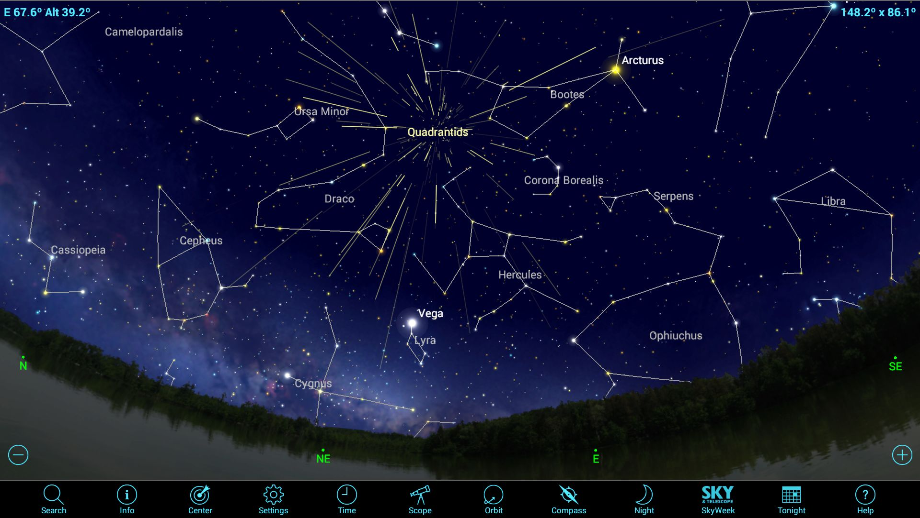
Observing – Meteor Showers
QUADRANTIDS (Active period Dec 26 to Jan 16)
Peaks evening of Tuesday, Jan 3, but watch before dawn Wednesday
Bright Moon sets at 4:30 am
Intense, but short peak period (~6 hours)
Up to 100 per hour, frequent bright fireballs
Source material may be comet C/1490 Y1
Named for abandoned constellation
Radiant ~9° NE of Nekkar, between Dra, Her, Boo, & UMa
Sky looking ENE at 5:30 am local time on Jan 4

Slide 26
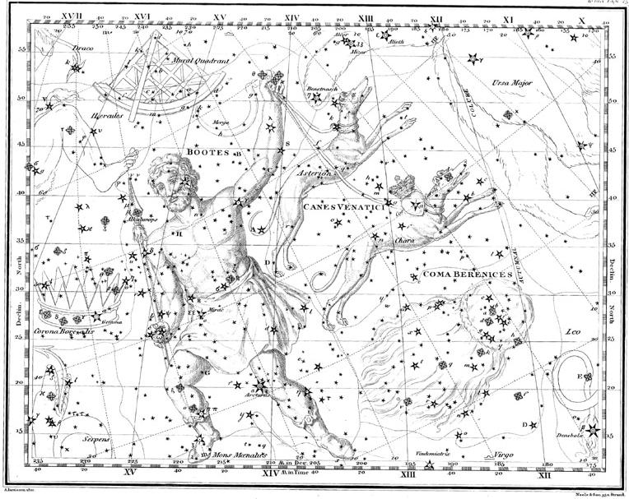
The Quadrant or Quadrans Muralis

Slide 27
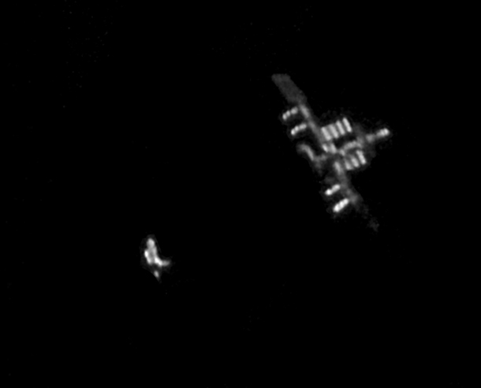
Observing Satellites – ISS Passes
Current GTA International Space Station (ISS) evening pass series lasts until Dec 10 (Most visible between 5:15 and 7 pm). A morning pass series runs from Dec 15 to Jan 8 (Most visible between 5:30 and 7 am). Another evening series commences on Jan 20.
Some higher/brighter ones include*:
Date Time Direction Alt. Mag.
Mon, 19-Dec 6:48 am to 6:54 am moves SW to ENE 83° -3.7
Wed, 21-Dec 6:48 am to 6:54 am moves W to NE 44° -3.4
Thu, 22-Dec 6:02 am to 6:06 am moves WNW to NE 66° -3.9
Mon, 3-Jan 6:02 am to 6:06 am moves N to ESE 58° -3.5
*far future predicted times may shift slightly
Image by Rob Bullen, Feb 26, 2011

Slide 28
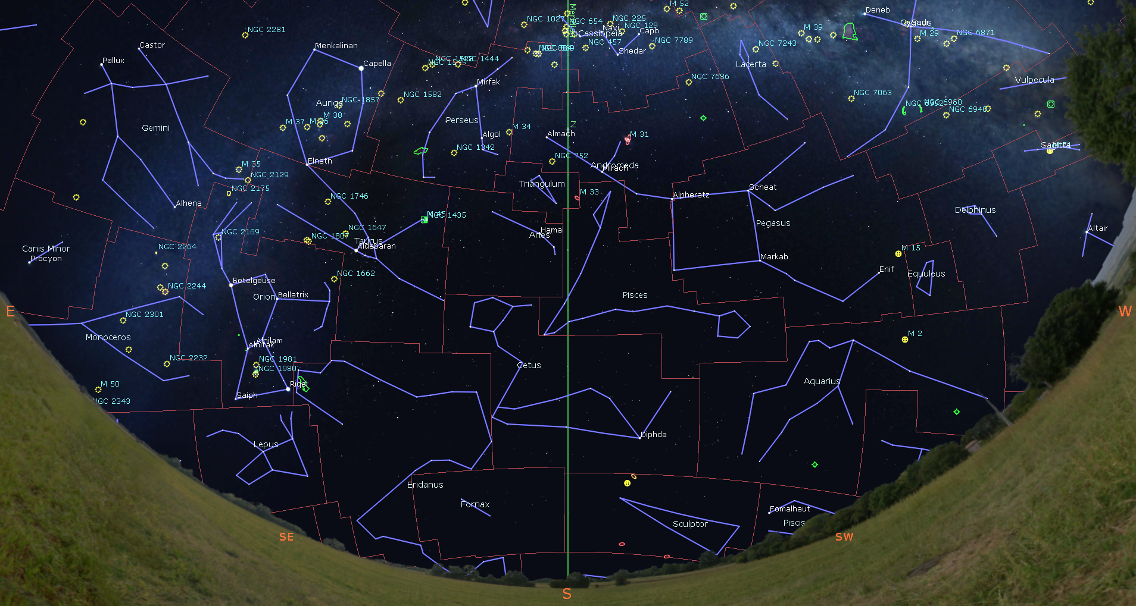
Constellations on the Meridian in Late December
8 pm: Sculptor,
Fornax, Cetus,
Eastern Pisces, Aries, Triangulum,
Andromeda,
Western Perseus,
and Cassiopeia
< 1.5 air masses
View south at 8 pm on Dec 22

Slide 29
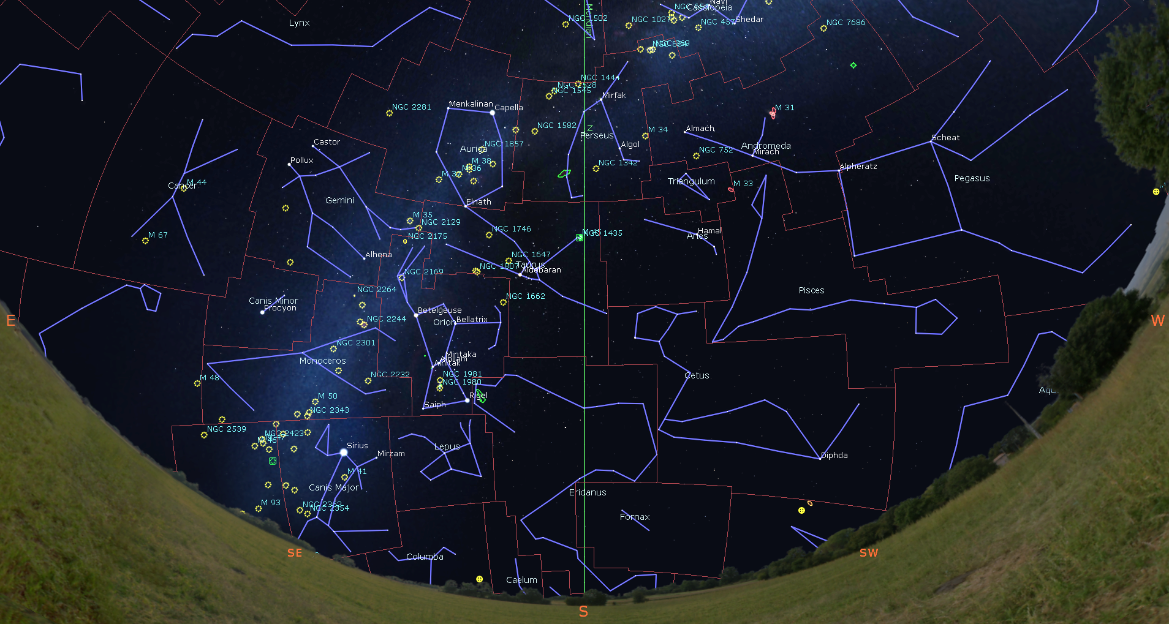
Constellations on the Meridian in Late December
10 pm: Fornax,
Eridanus, NE Cetus, Taurus,
Eastern Aries,
Perseus, and Camelopardalis
< 1.5 air masses
View south at 10 pm on Dec 22

Slide 30
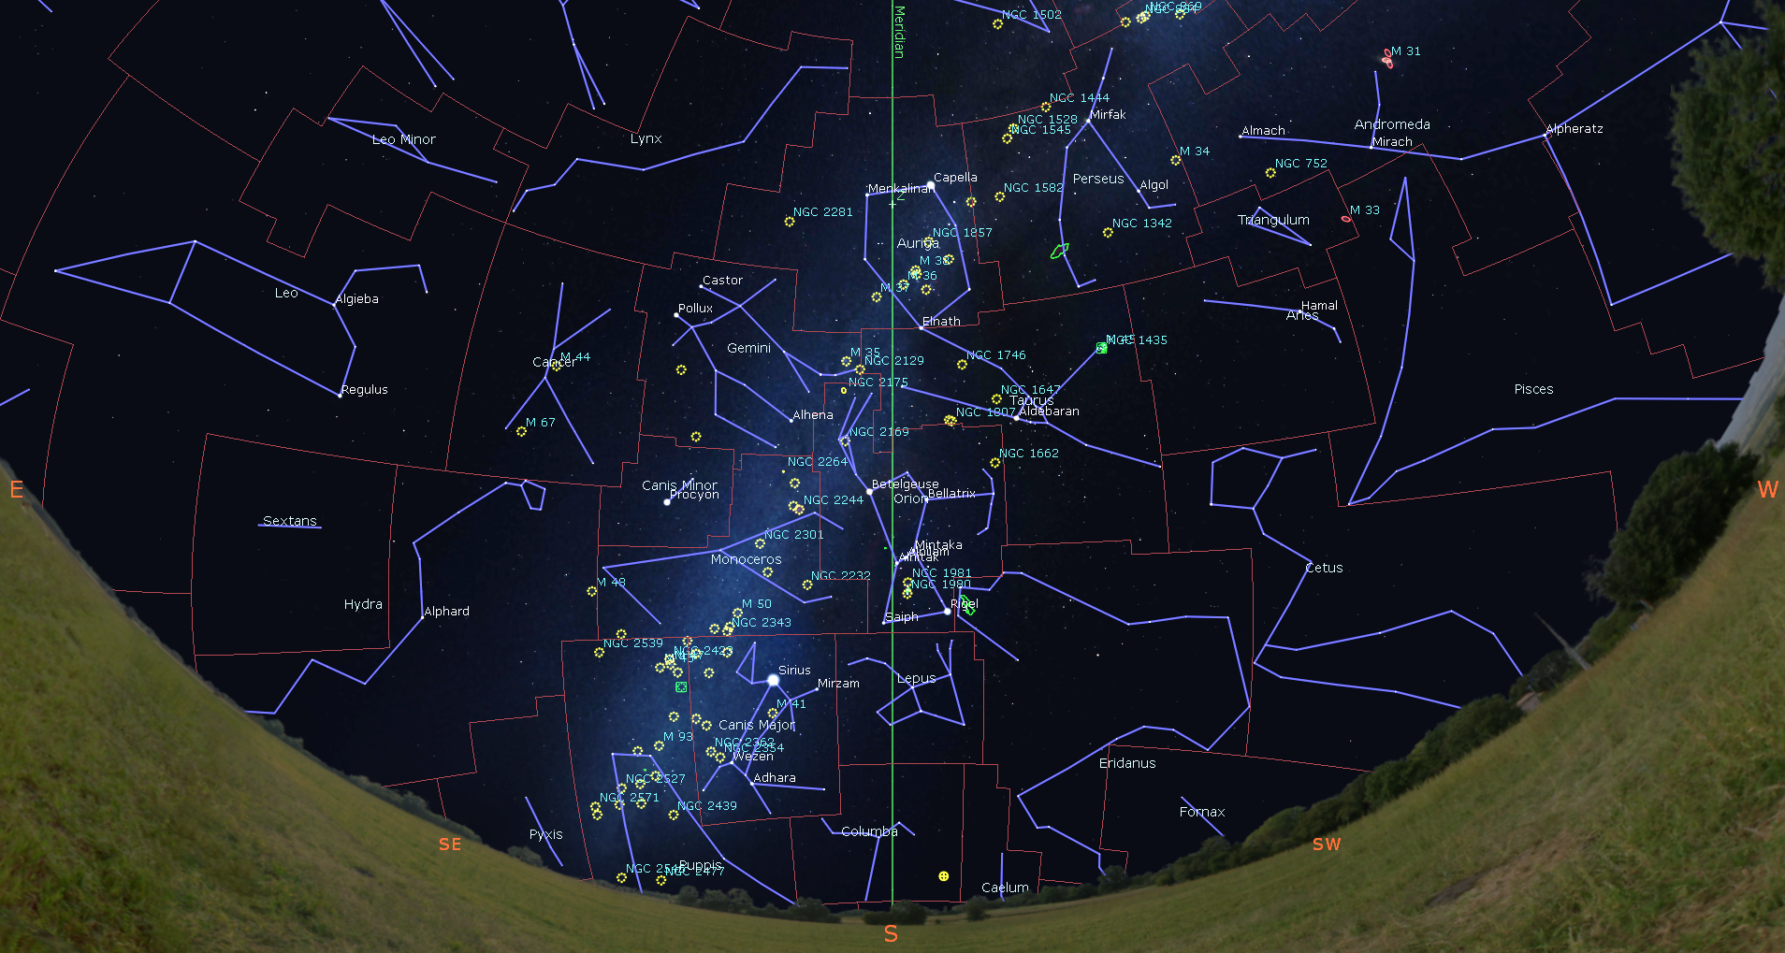
Constellations on the Meridian in Late December
12 am: Columba,
Lepus, Orion,
Western Gemini,
Eastern Taurus,
Auriga, Western Lynx,
and Camelopardalis
< 1.5 air masses
View south at 12 am on Dec 22

Slide 31
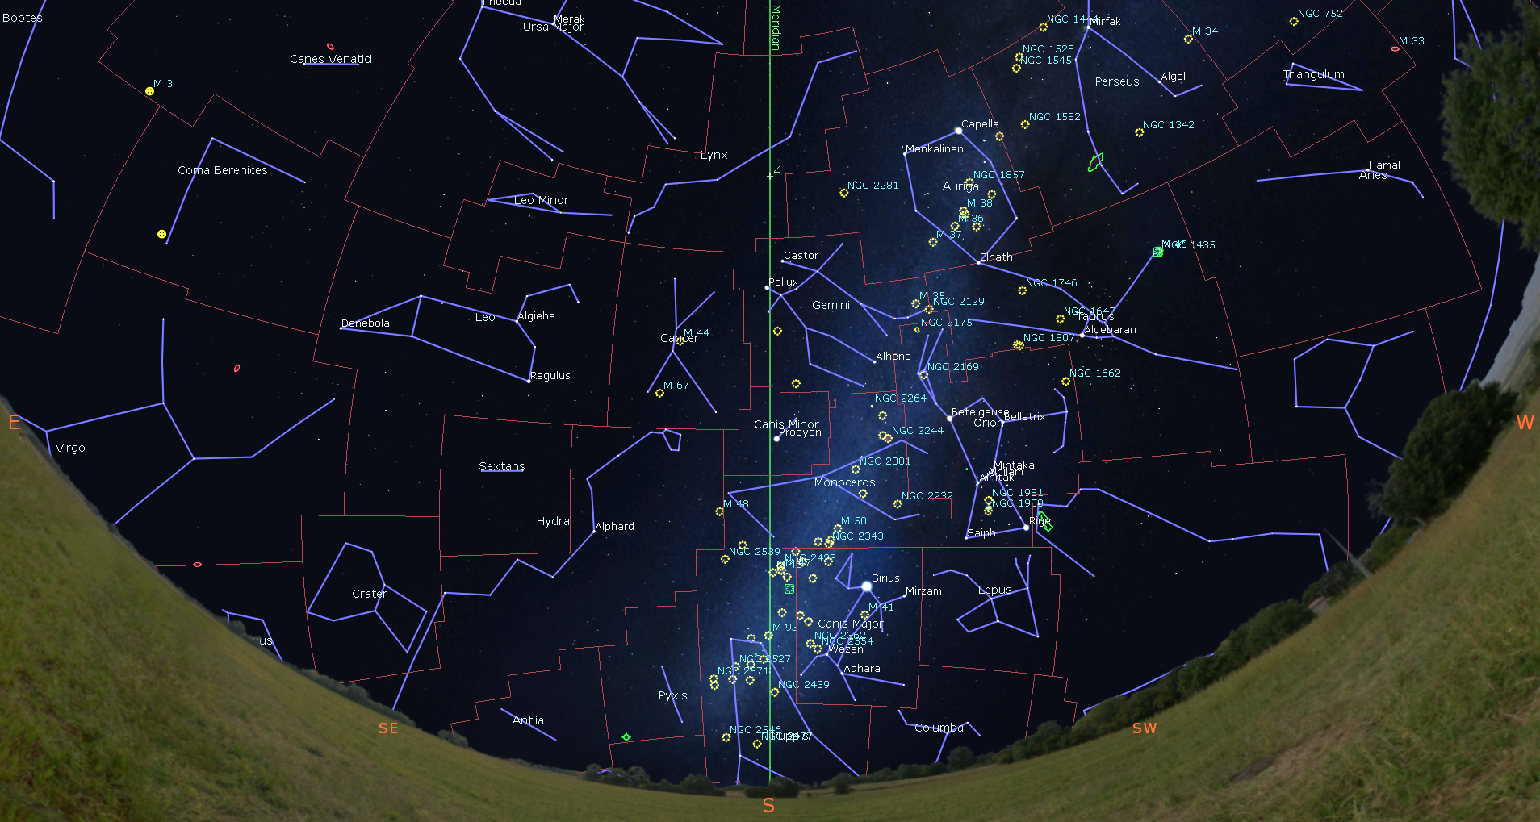
Constellations on the Meridian in Early January
2 am: Puppis,
Canis Major,
Monoceros,
Canis Minor,
Eastern Gemini,
Western Cancer,
and Lynx
< 1.5 air masses
View south at 2 am on Dec 23

Slide 32
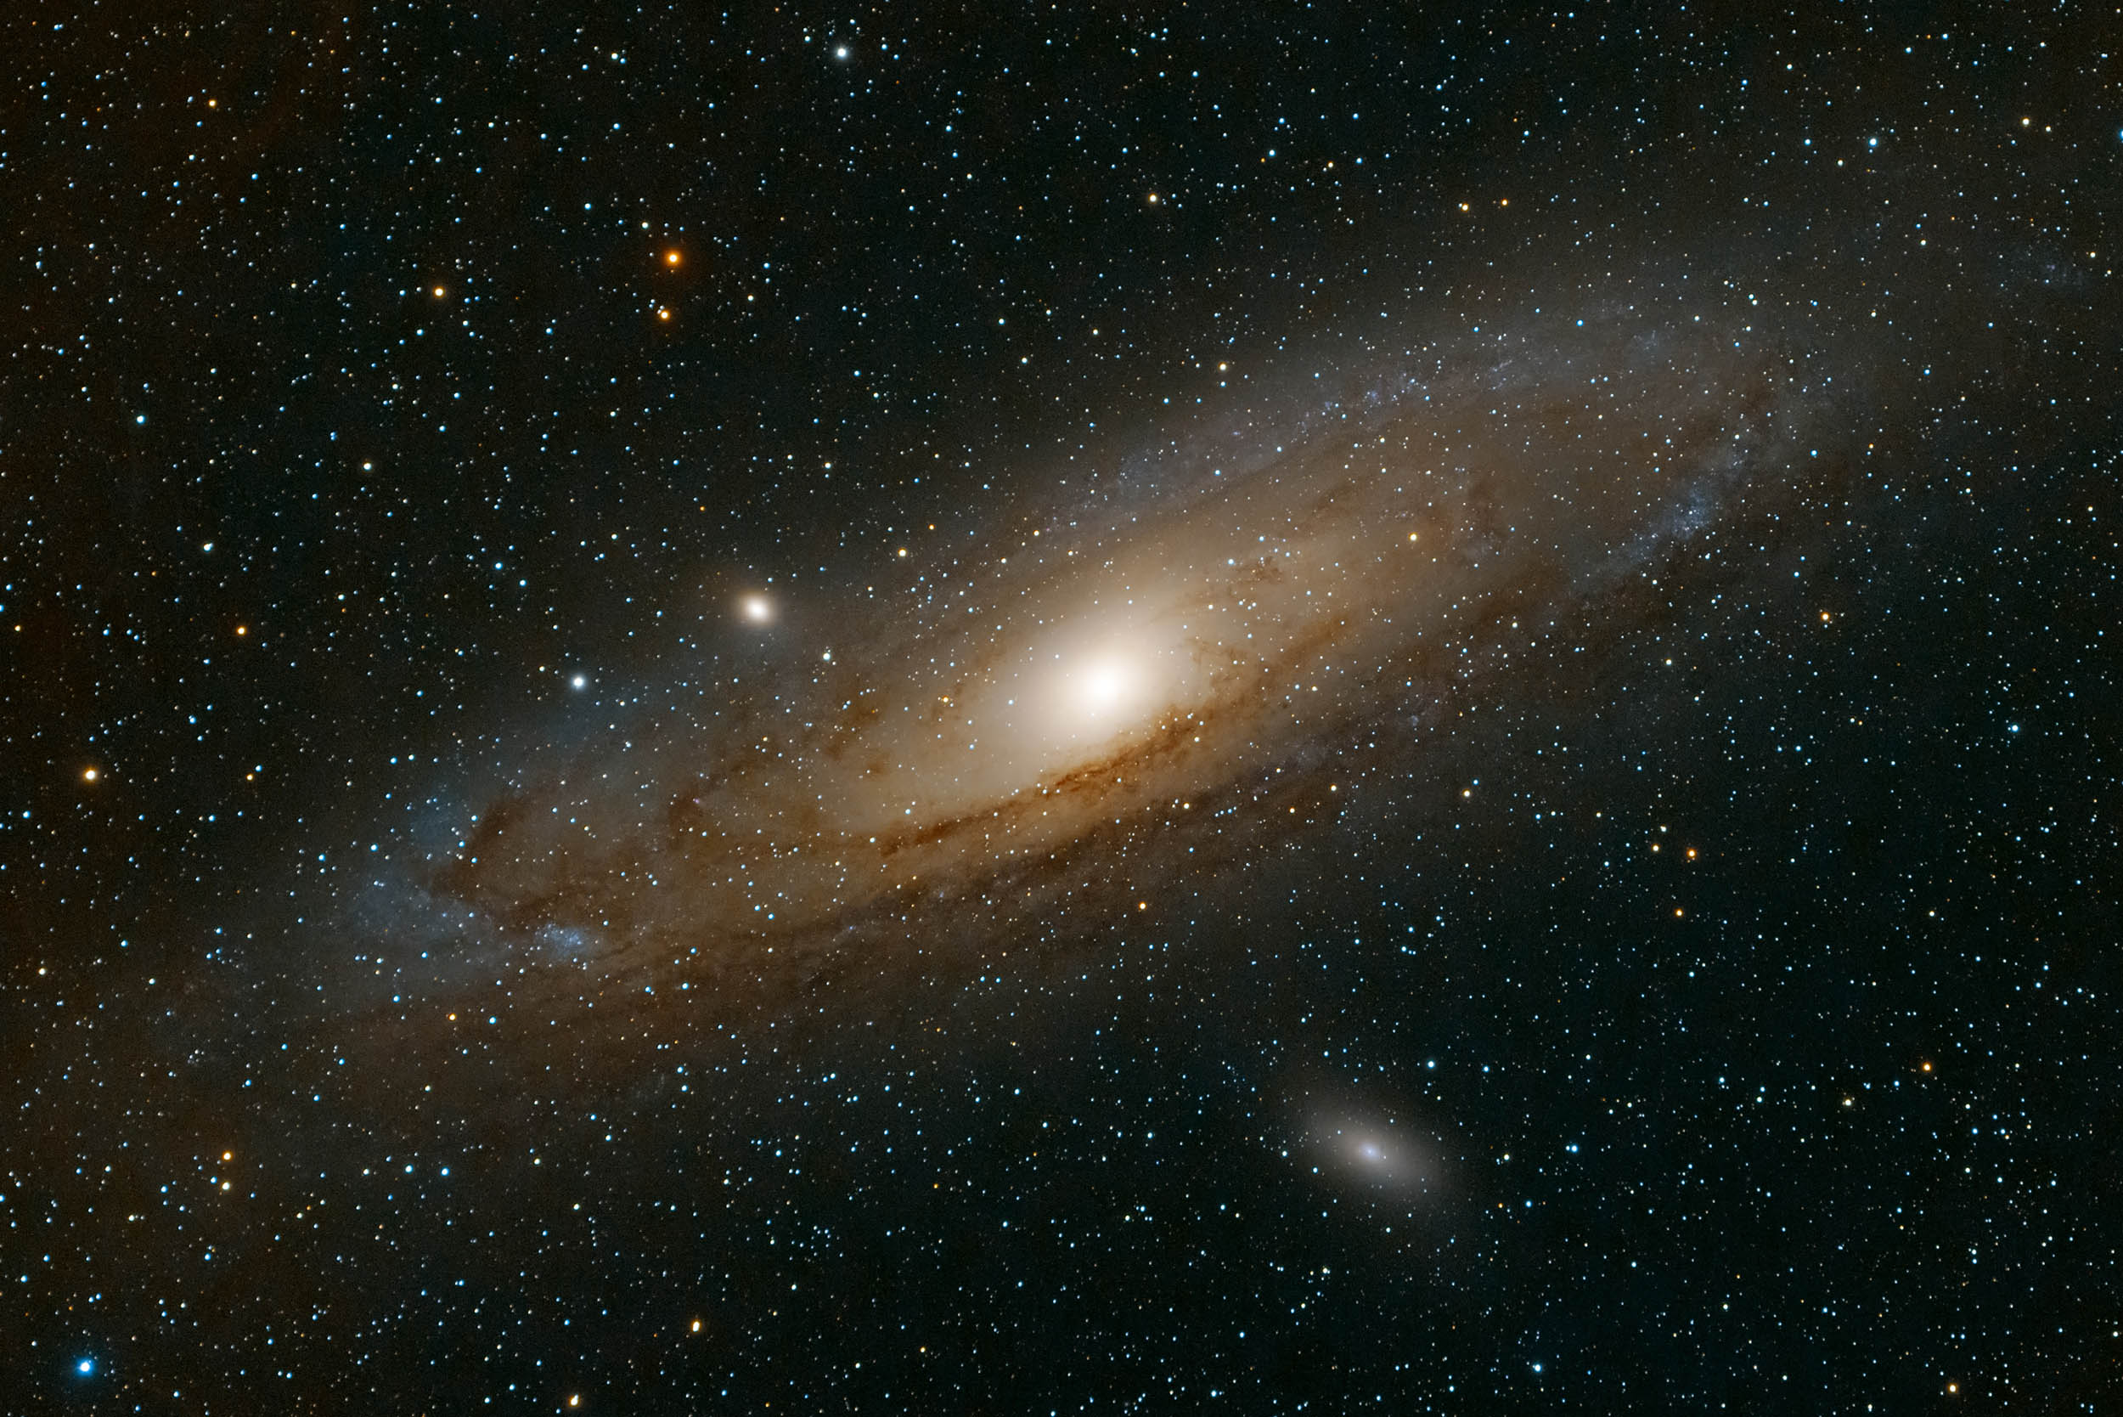
Early Winter Star Party Targets
Holiday Packages - Winter Milky Way, Orion’s Belt, Hyades in Taurus, Square of Pegasus (eye / binos)
Christmas Lights – NGC457 Owl/ET (Cas), NGC884, 869 Double Cluster (Per), M45 The Pleiades (Tau), etc. (binos / telescope)
Festive Candles – M42 Orion Nebula and M78 (Ori), Heart & Soul Nebulae (Cas), etc. (binos / telescope)
Ornaments – M31 (And), M81, 82 Bode’s (Uma), Blinking Planetary (Cyg), M56 (Tri), Blue Snowball (And) (binos / telescope)
Make it a Double – Castor (Gem), Almaak (And), Polaris (UMi), etc. (binos / telescope)
Centerpieces - Betelgeuse and Rigel (Ori), Capella (Aur), Aldebaran (Tau)(eye / binos / telescope)
Andromeda Galaxy by Malcolm Park

Slide 33
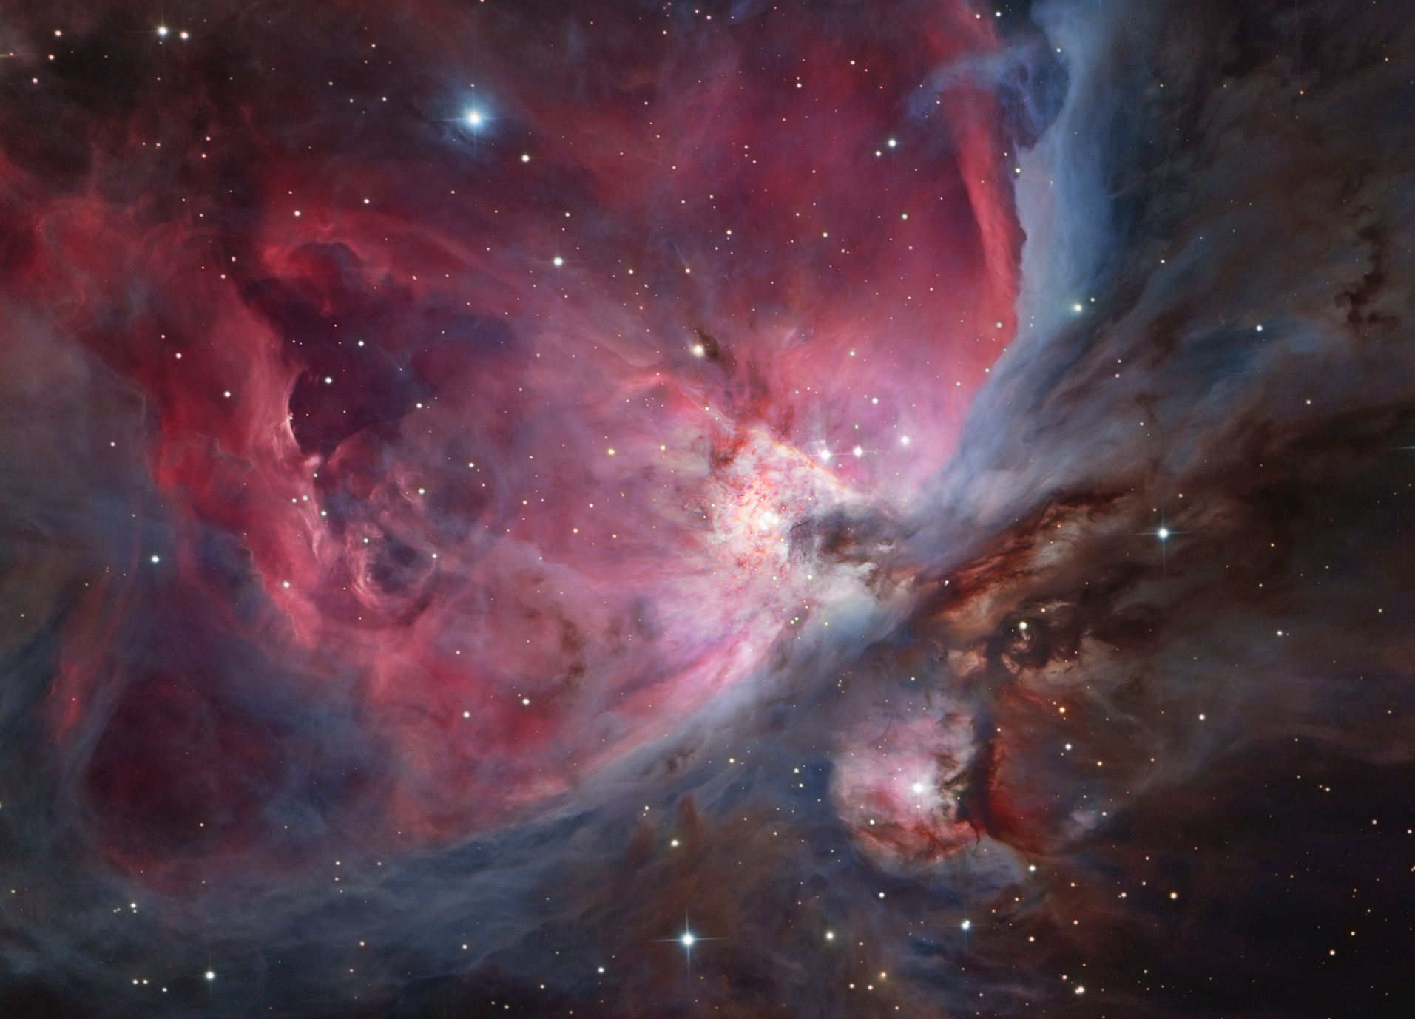
THANK YOU!
Orion Nebula by László Francsics, APOD Jan 2, 2015

